Slide 1
Public Transport
Optimization

Slide 2
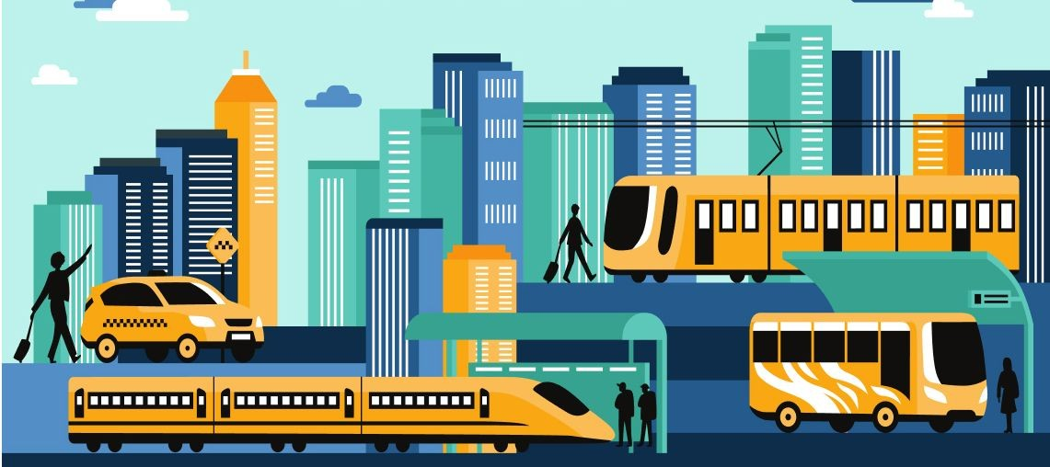
Introduction
Connectivity can improve the customer experience, optimize transportation, and create new opportunities for economic growth.
Thanks to technological advances and the transition to the Internet of Things, we communicate through strong virtual channels, work remotely and can receive medical care remotely. Nomad-Digital, the UK’s leading transport IP provider, explores the various trends and innovations that will revolutionize the future of transport connectivity and ensure the provision of a seamless door-to-door experience
TRANSPORTATION
OPTIMIZATION is the process of analyzing shipments, rates and. constraints to produce realistic load plans that reduce overall freight spend and gain efficiencies across
entire transportation networks

Slide 3
Protocol
•The stopping time of each station is the same
•The departure interval of all routes is the same;
The waiting time of passengers on different paths is calculated according to the expected value
Transfer paths more than two are not considered;
Combine upstream and downstream passenger flows to construct the network as an undirected network.
The origin and destination are determined by referring to the origin and destination of the existing bus routes.

Slide 4
Connectivity
Connected vehicles are not new in terms of technological innovation. In this regard, it must be said that between 2017 to 2022, the estimated stock of connected cars in the UK was expected to rise from 4.86 million to 16.65 million, an increase of 242%.
What characterizes connected vehicles is their connection to an external network, such as a phone, Bluetooth, GPS or an internal SIM, and more commonly the Internet, via an internal SIM card. This allows you to stay connected to your car and communicate when you’re not in it, usually through an app on your smartphone. This will allow you to perform various functions, such as connecting to your car radio, using in-car assistants like Amazon Alexa, receiving traﬃc updates, and even remotely starting the car.
With technological advances, the future of connected vehicles looks brighter than ever. With a 5G-enabled connection, cars will become fully connected and integrated hubs.
Connected vehicle-to-vehicle (V-2-V) technology also enables vehicle-to-vehicle
communication to share vital travel information such as road conditions, traﬃc and speed limits.

Slide 5
Sensors
Sensor technology is a vital component used for data collection during Vehicle-to-Vehicle (V2V) and Vehicle to Infrastructure (V2I) communications. This data is then provided to transportation management systems for further processing and analysis and subsequent decisions/actions.
•The RFID technologies and GPS are used to collect data from different parking
spots and can offer drivers a wide variety of opportunities to park their vehicles
•The Parking spot locator applications allow drivers to find available parking places at locations such as streets, garages, or parking lots.
•The Map download applications help drivers to get valuable information from important places or home stations. Drivers can download travel guidance maps before traveling to a new area to get directions even in location without Internet connection. One disadvantage of this application is its high costs of installation, deployment and maintenance of the data collection, infrastructure (cameras, sensors, among others) and the communication systems to facilitate information transmission to the relevant processing centers

Slide 6
•The Driver’s emotions recognition applications focus on detecting signs of irritation or depression that impair driving. Using Electromyogram (EMG), ECG, respiration, and Electro Dermal Activity (EDA) sensor emotions such as high or low stress, euphoria and disappointment combined with sophisticated algorithms such as Support vector machines (SVMs) and Adaptive Neuro-Fuzzy Interference System (ANFIS), emotions can be detected and classified. In this context, several past works have focused on drivers’ emotion recognition
•The Road Surface State applications use infrared sensors to measure the infrared radiation emitted by the surface and applying intelligent signal processing to remotely measure road parameters such as: temperature, amount of water, ice, and snow.One variation is the road surface anomalies monitoring application that use sensors such as GPS, laser, infrared, and accelerometers inside vehicle to detect anomalies such as potholes or speed bumps. The collected information is used to create an anomalies map for drivers and help road managers to execute infrastructure maintenance and management operations to ensure safety and comfort to drivers

